Slide 1
Chap.5 Microwave network analysis
5.1 Impedance and Equivalent voltages and currents
5.1.1 Equivalent voltages and currents
At microwave frequencies the measurement of voltage or current is difficult (or impossible), unless a clearly defined terminal pair is available.
Such a terminal pair may be present in the case of TEM-type lines, but does not strictly exist for non-TEM lines.

Slide 2
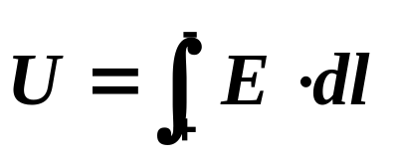
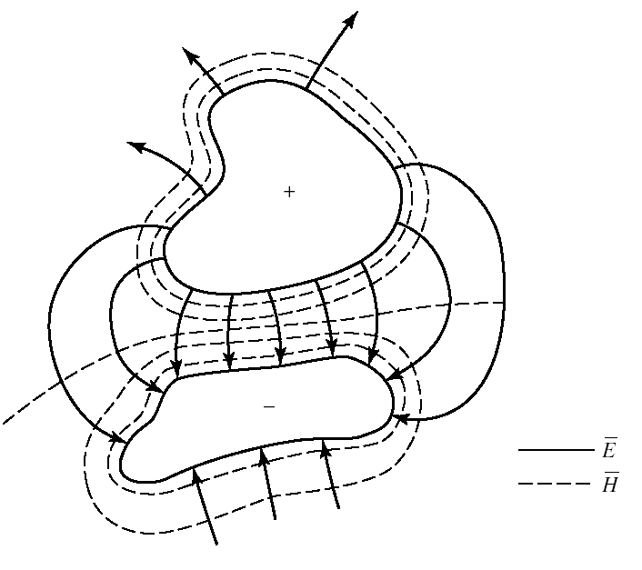
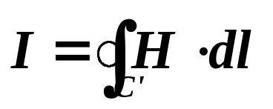
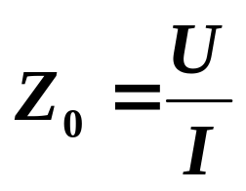
5.1 Impedance and Equivalent voltages and currents
because of the electrostatic nature of the transverse fields between the two conductors, the voltage defined is unique
integration contour is any closed path enclosing the +conductor (but not the - conductor)
Electric and magnetic field lines
for an arbitrary two-conductor TEM line.
then the circuit theory for transmission lines can be applied to characterize this line as a circuit element.

Slide 3
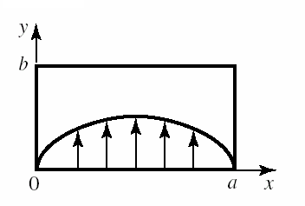
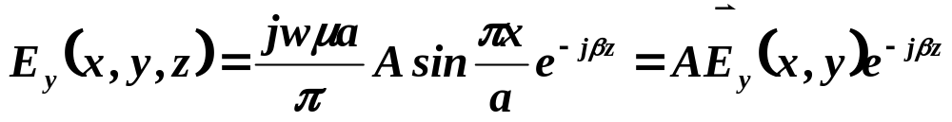
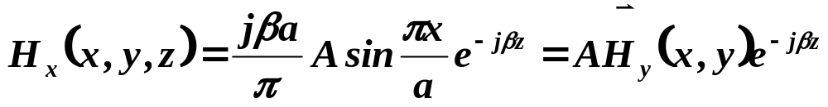
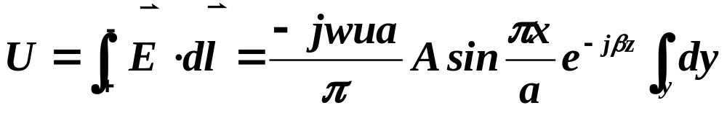
5.1 Impedance and Equivalent voltages and currents
This situation is more difficult for waveguide
For the dominant TE10 mode
Electric field lines for the TE₁₀ mode of a rectangular waveguide
Voltage depends on the position x, as well as the length of the integration contour along the y direction
there is no ‘correct’ voltage in the sense of being unique or pertinent for all applications.
A similar problem arises with current , and also impedance.

Slide 4
5.1 Impedance and Equivalent voltages and currents
following considerations usually lead to the most useful results:
voltage and current are defined only for a particular waveguide mode
voltage is proportional to the transverse electric field, and the current is proportional to the transverse magnetic field
In order to be used in a manner similar to voltages and currents of circuit theory, the equivalent voltages and currents should be defined so that their product gives the power flow of the mode.
The ratio of the voltage to the current for a single traveling wave should be equal to the characteristic impedance of the line. This impedance may be chosen arbitrarily, but is usually selected as equal to the wave impedance of the line, or else normalized to unity.

Slide 5
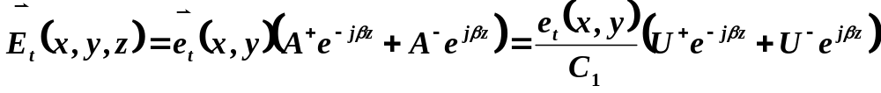
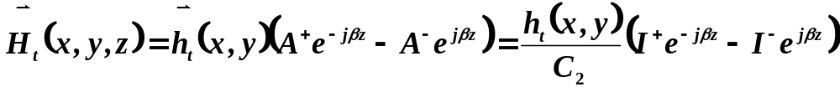
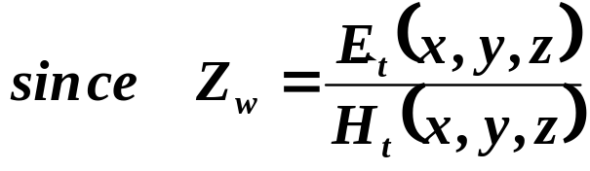
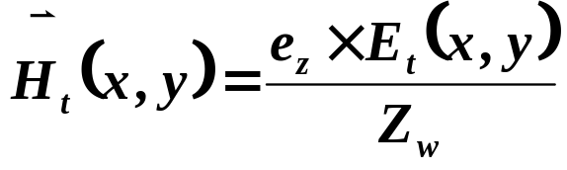
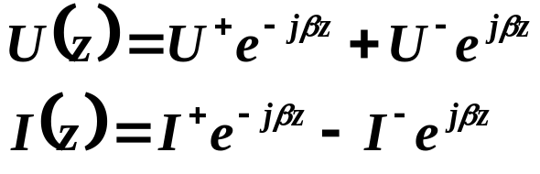
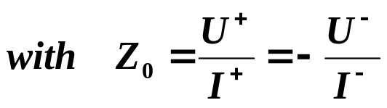
5.1 Impedance and Equivalent voltages and currents
Defines equivalent voltage and current waves as

Slide 6
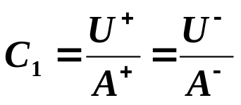
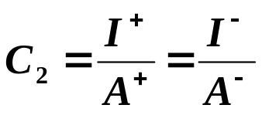
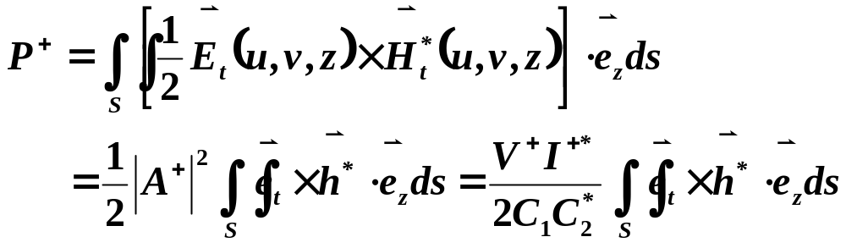
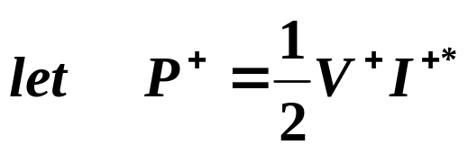
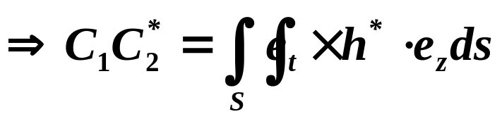

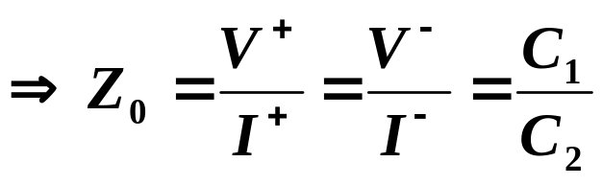
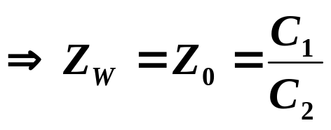
5.1 Impedance and Equivalent voltages and currents
The complex power flow for the incident wave is given by:
If it is desired to have Z0=Zw, then

Slide 7
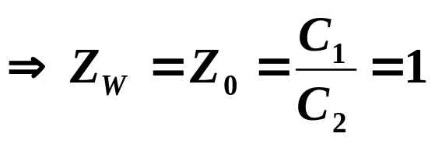
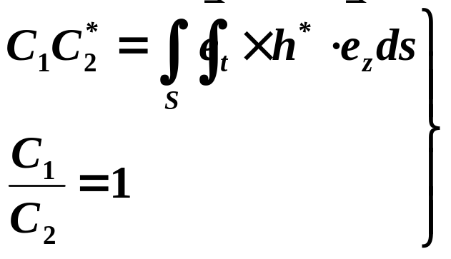

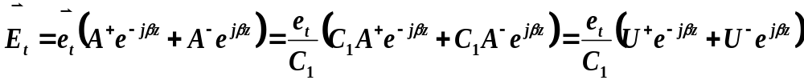
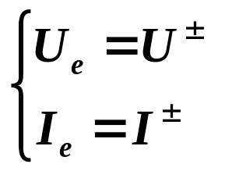
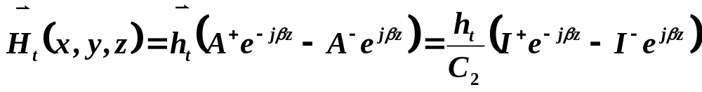
5.1 Impedance and Equivalent voltages and currents
Alternatively, it may be desired to normalize the characteristic impedance to unity(Z0=1)
So for a given wave guide mode,

Slide 8
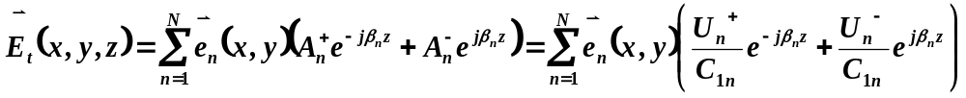
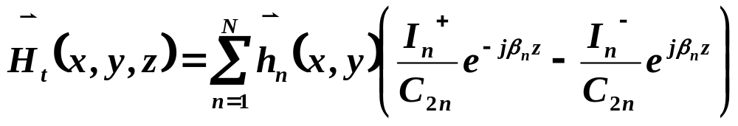
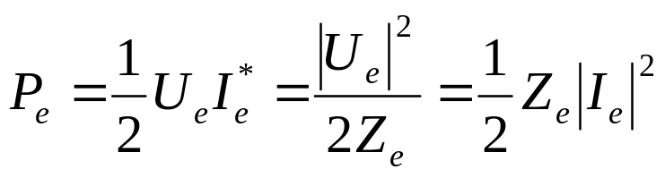
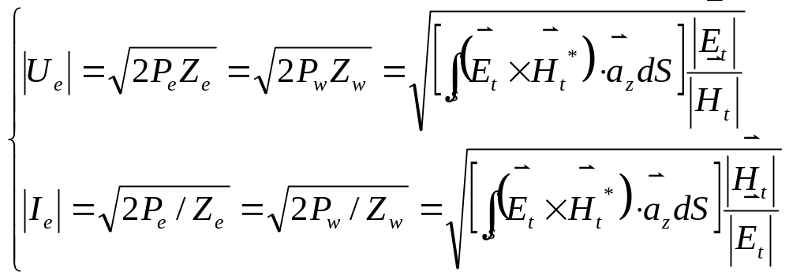
5.1 Impedance and Equivalent voltages and currents
Higher order modes can be treated in the same way, so that a general field in a waveguide can be expressed in the following form:

Slide 9
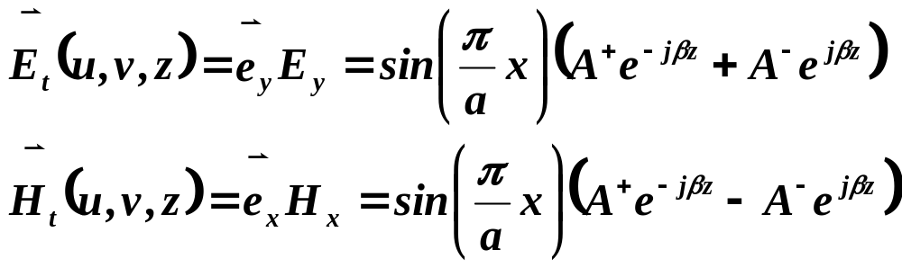
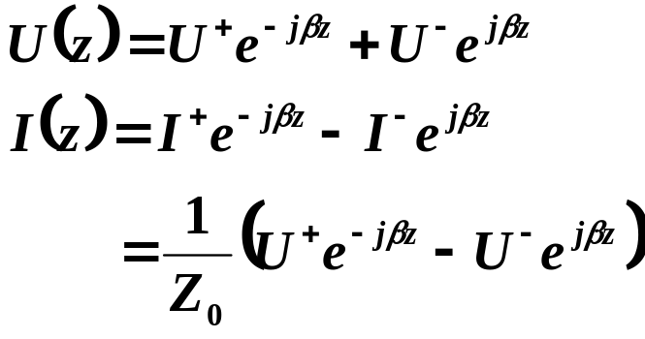
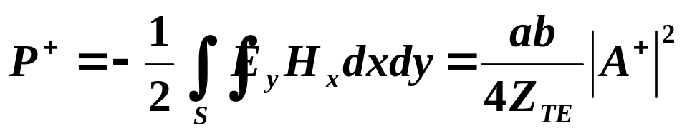
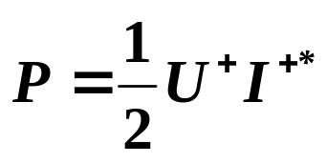
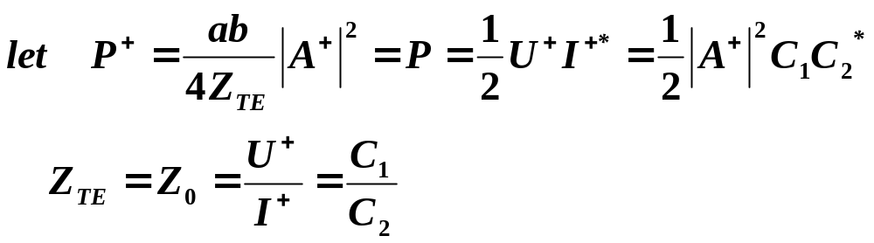
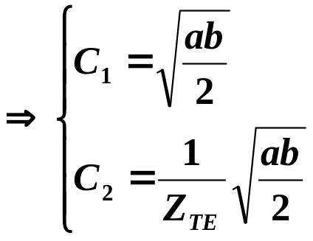
5.1 Impedance and Equivalent voltages and currents
Example: Find the equivalent voltages and currents for a TE10 mode in a rectangular waveguide

Slide 10
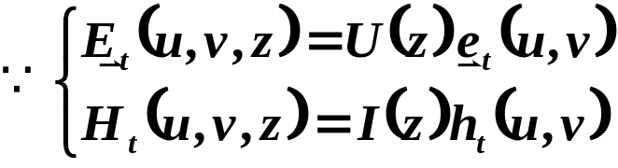
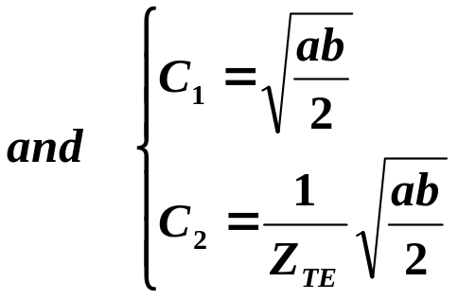
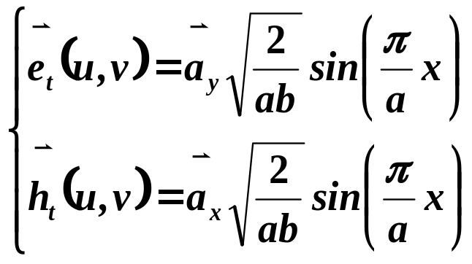
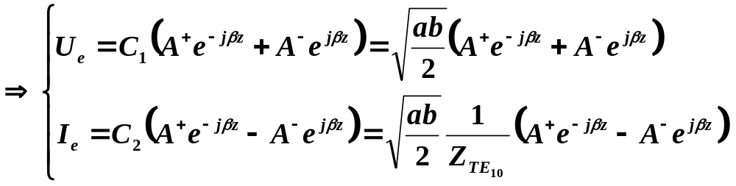
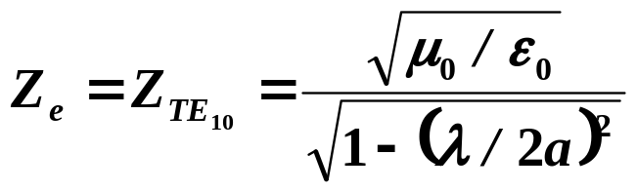
5.1 Impedance and Equivalent voltages and currents

Slide 11
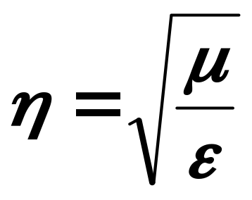
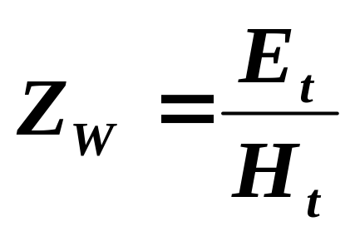
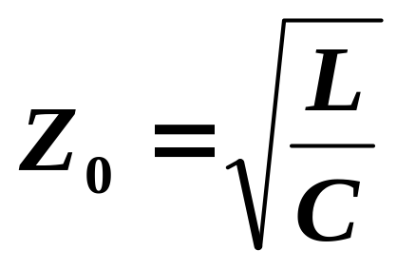
5.1 Impedance and Equivalent voltages and currents
5.1.2 Concept of Impedance
Intrinsic impedance of the medium.
Dependent only on the material parameter of the medium, and is equal to the wave impedance for plane wave
wave impedance
It is a characteristic of the particular type of wave. Dependent on the type of mode, line, the material and the operating frequency
Characteristic impedance
Ratio of voltage to current for a traveling wave
Z0 of TEM are uniquely for TEM waves, but not for TE and TM waves which don’t have a uniquely defined voltage and current

Slide 12
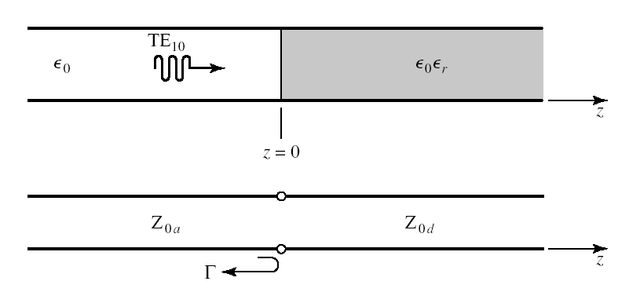
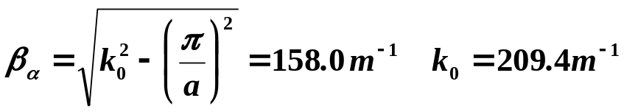
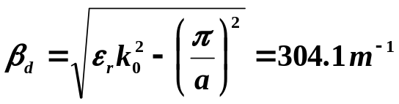
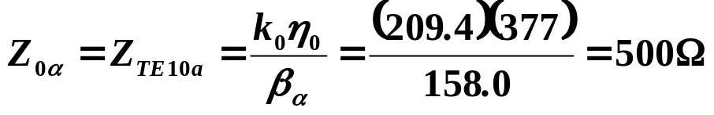
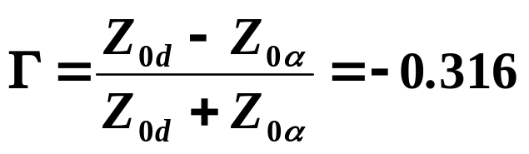
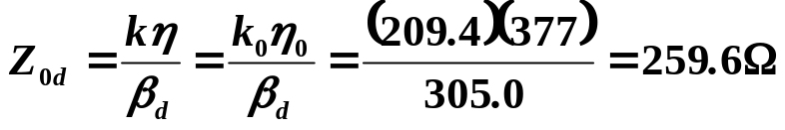
5.1 Impedance and Equivalent voltages and currents
Example: application of waveguide impedance
Consider a 2.286cm*1.016cm rectangular waveguide, air filled for z<0, and Rexolite (εr=2.54) filled for z>0. If the operating frequency is 10GHz, use an equivalent transmission line model to compute the reflection coefficient of a TE10 wave incident on the interface from z < 0
With this result, expressions for the incident, reflected, and transmitted waves can be written in terms of fields, or in terms of equivalent voltages and currents

Slide 13








5.1 Impedance and Equivalent voltages and currents
Consider an arbitrary one-port network, and derive a general relation between its impedance properties and electromagnetic energy stored in, and the power dissipated by the network
The complex power delivered to this network
If the network is lossless, then P_{l}=0 and R=0.
Then Zin is purely imaginary, which is positive for an inductive load (W_{m}>W_{e}), and negative for a capacitive load (W_{m}<W_{e})

Slide 14







5.1 Impedance and Equivalent voltages and currents
5.1.3 Even and Odd Properties of Z(w) and Γ(w)
Consider the driving point impedance at the input port of an electrical network
Since v(t) must be real
Re{V(w)} is even in w, while Im{V(w)} is odd in w
similar results hold for I(w) and Z(w)
The real and imaginary parts of Γ(w) are even and odd,respectively
And |Γ|² and| Γ | are even function of w
It implies that only even series of the form a +bw²+cw⁴+… can be used to represent |Γ(w)| or or |Γ(w)| ²

